Slide 1
Implementing
multi layer perceptron

Slide 11
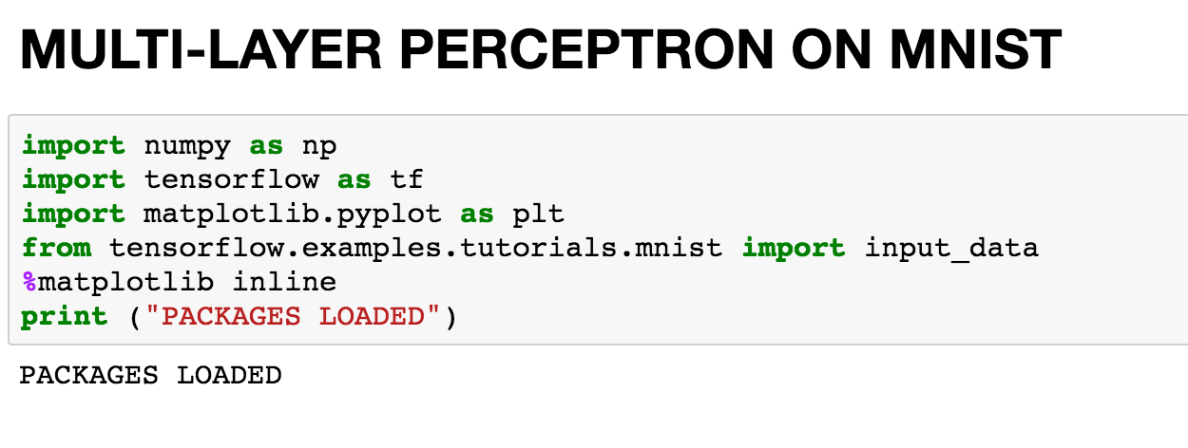
Import packages
Notes:
import numpy as np
import tensor flow as tf
import matplotlib.pyplot as plt
from tensorflow.examples.tutorials.mnist
import input_data
%matplotlib inline print ("PACKAGES LOADED")

Slide 12
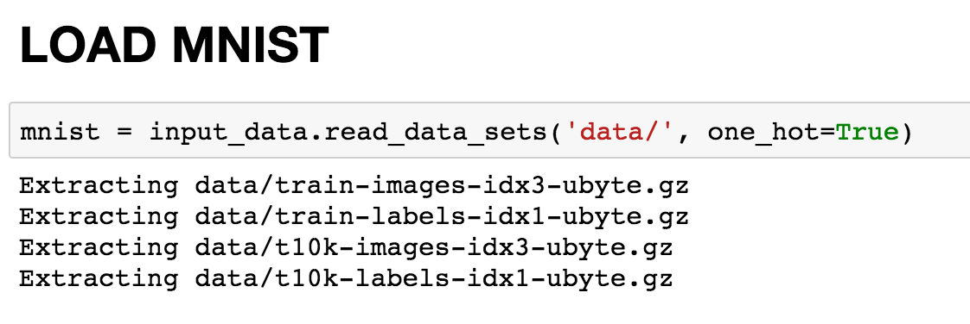
Notes:
mnist = input_data.read_data_sets('data/', one_hot=True)

Slide 13
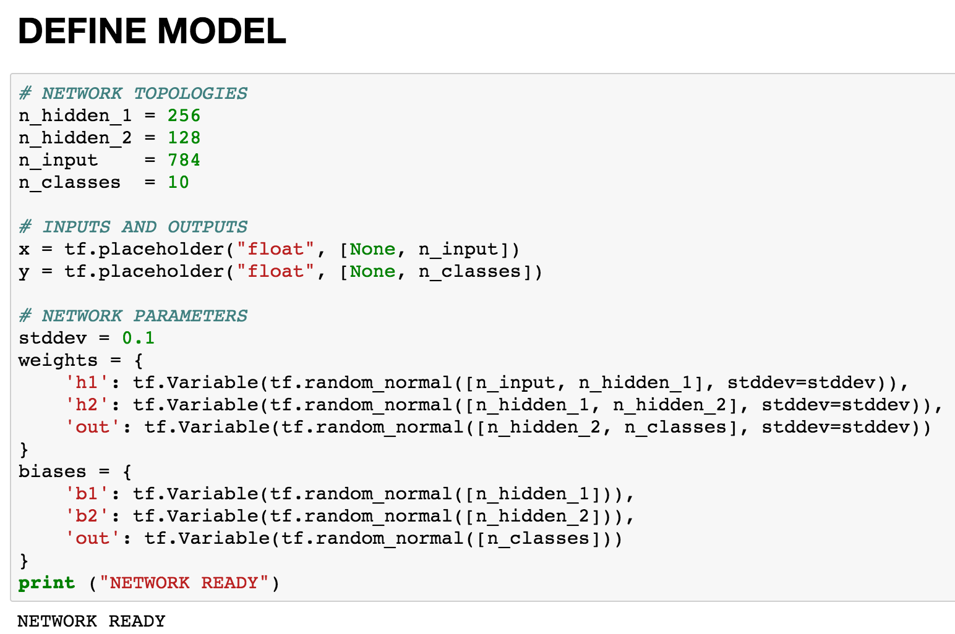
Notes:
# NETWORK TOPOLOGIES
n_hidden_1 = 256
n_hidden_2 = 128
n_input = 784
n_classes = 10
# INPUTS AND OUTPUTS
x = tf.placeholder("float", [None, n_input])
y = tf.placeholder("float", [None, n_classes])
# NETWORK PARAMETERS
stddev = 0.1
weights = {
'h1': tf.Variable(tf.random_normal([n_input, n_hidden_1], stddev=stddev)),
'h2': tf.Variable(tf.random_normal([n_hidden_1, n_hidden_2], stddev=stddev)),
'out': tf.Variable(tf.random_normal([n_hidden_2, n_classes], stddev=stddev))
}
biases = {
'b1': tf.Variable(tf.random_normal([n_hidden_1])),
'b2': tf.Variable(tf.random_normal([n_hidden_2])),
'out': tf.Variable(tf.random_normal([n_classes]))
}
print ("NETWORK READY")

Slide 14
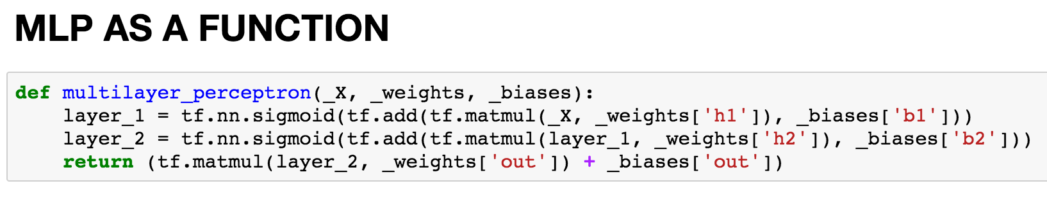
Notes:
def multilayer_perceptron(_X, _weights, _biases):
layer_1 = tf.nn.sigmoid(tf.add(tf.matmul(_X, _weights['h1']), _biases['b1']))
layer_2 = tf.nn.sigmoid(tf.add(tf.matmul(layer_1, _weights['h2']), _biases['b2']))
return (tf.matmul(layer_2, _weights['out']) + _biases['out'])

Slide 15
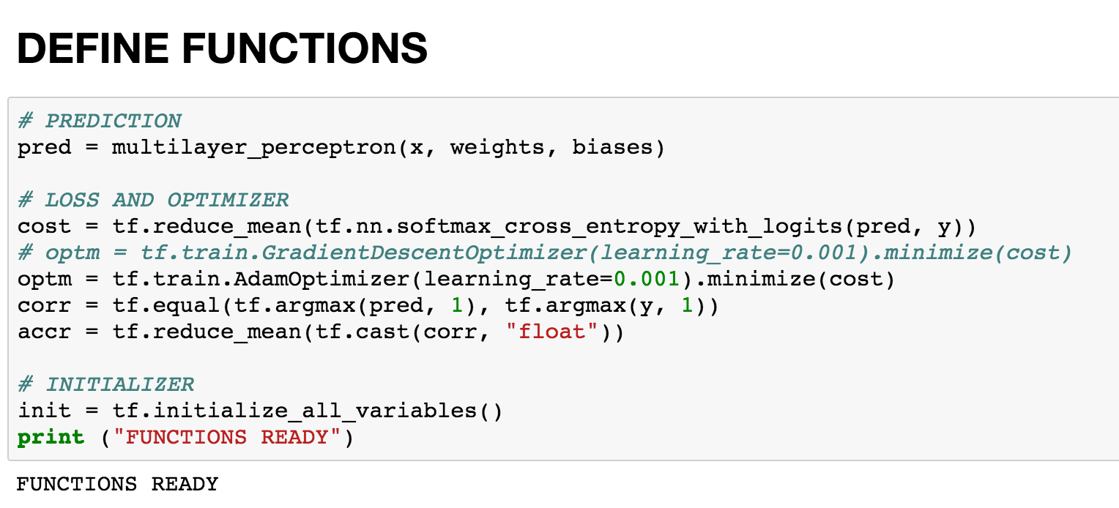
Notes:
# PREDICTION
pred = multilayer_perceptron(x, weights, biases)
# LOSS AND OPTIMIZER
cost = tf.reduce_mean(tf.nn.softmax_cross_entropy_with_logits(pred, y)) # optm = tf.train.GradientDescentOptimizer(learning_rate=0.001).minimize(cost)
optm = tf.train.AdamOptimizer(learning_rate=0.001).minimize(cost)
corr = tf.equal(tf.argmax(pred, 1), tf.argmax(y, 1))
accr = tf.reduce_mean(tf.cast(corr, "float"))
# INITIALIZER
init = tf.initialize_all_variables()
print ("FUNCTIONS READY")

Slide 16
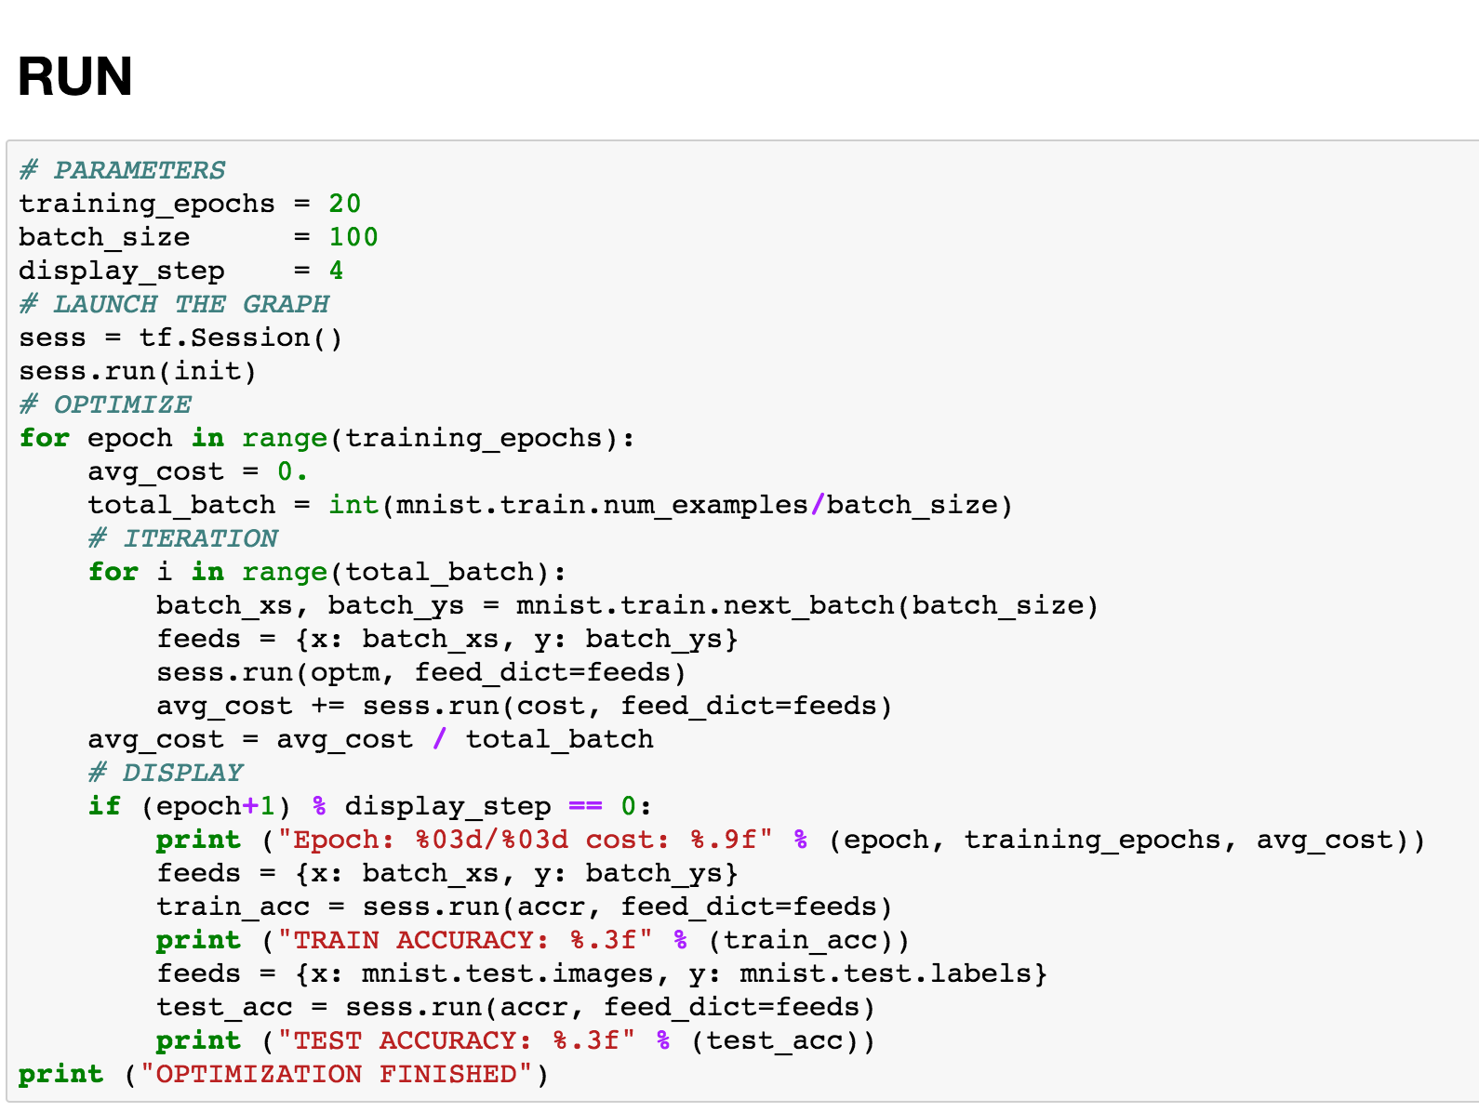
Notes:
# PARAMETERS
training_epochs = 20
batch_size = 100
display_step = 4
# LAUNCH THE GRAPH
sess = tf.Session()
sess.run(init)
# OPTIMIZE
for epoch in range(training_epochs):
avg_cost = 0.
total_batch = int(mnist.train.num_examples/batch_size)
# ITERATION
for i in range(total_batch):
batch_xs, batch_ys = mnist.train.next_batch(batch_size)
feeds = {x: batch_xs, y: batch_ys}
sess.run(optm, feed_dict=feeds)
avg_cost += sess.run(cost, feed_dict=feeds)
avg_cost = avg_cost / total_batch
# DISPLAY
if (epoch+1) % display_step == 0:
print ("Epoch: %03d/%03d cost: %.9f" % (epoch, training_epochs, avg_cost))
feeds = {x: batch_xs, y: batch_ys}
train_acc = sess.run(accr, feed_dict=feeds)
print ("TRAIN ACCURACY: %.3f" % (train_acc))
feeds = {x: mnist.test.images, y: mnist.test.labels}
test_acc = sess.run(accr, feed_dict=feeds)
print ("TEST ACCURACY: %.3f" % (test_acc))
print ("OPTIMIZATION FINISHED")

Slide 17
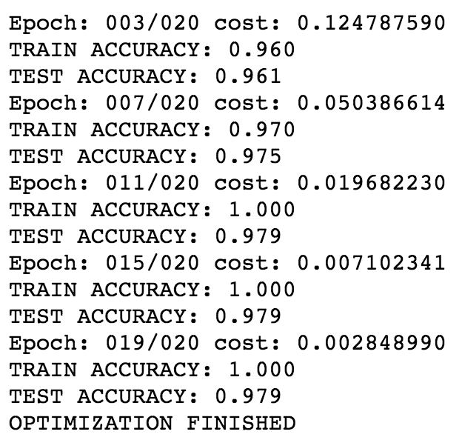

Slide 18
Implementing
“deeper”
multi layer perceptron

Slide 19
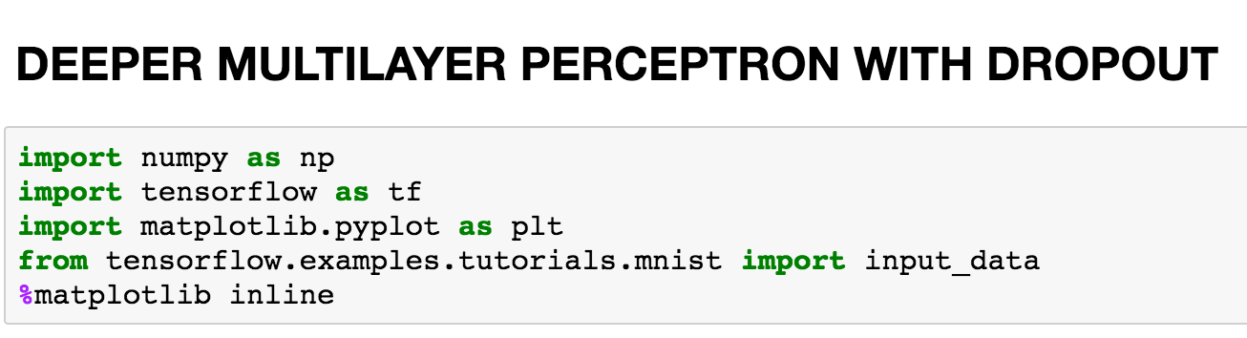

Slide 20
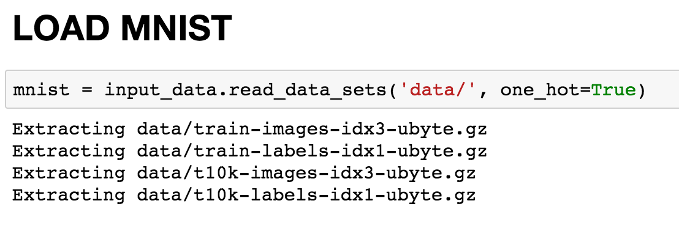

Slide 21
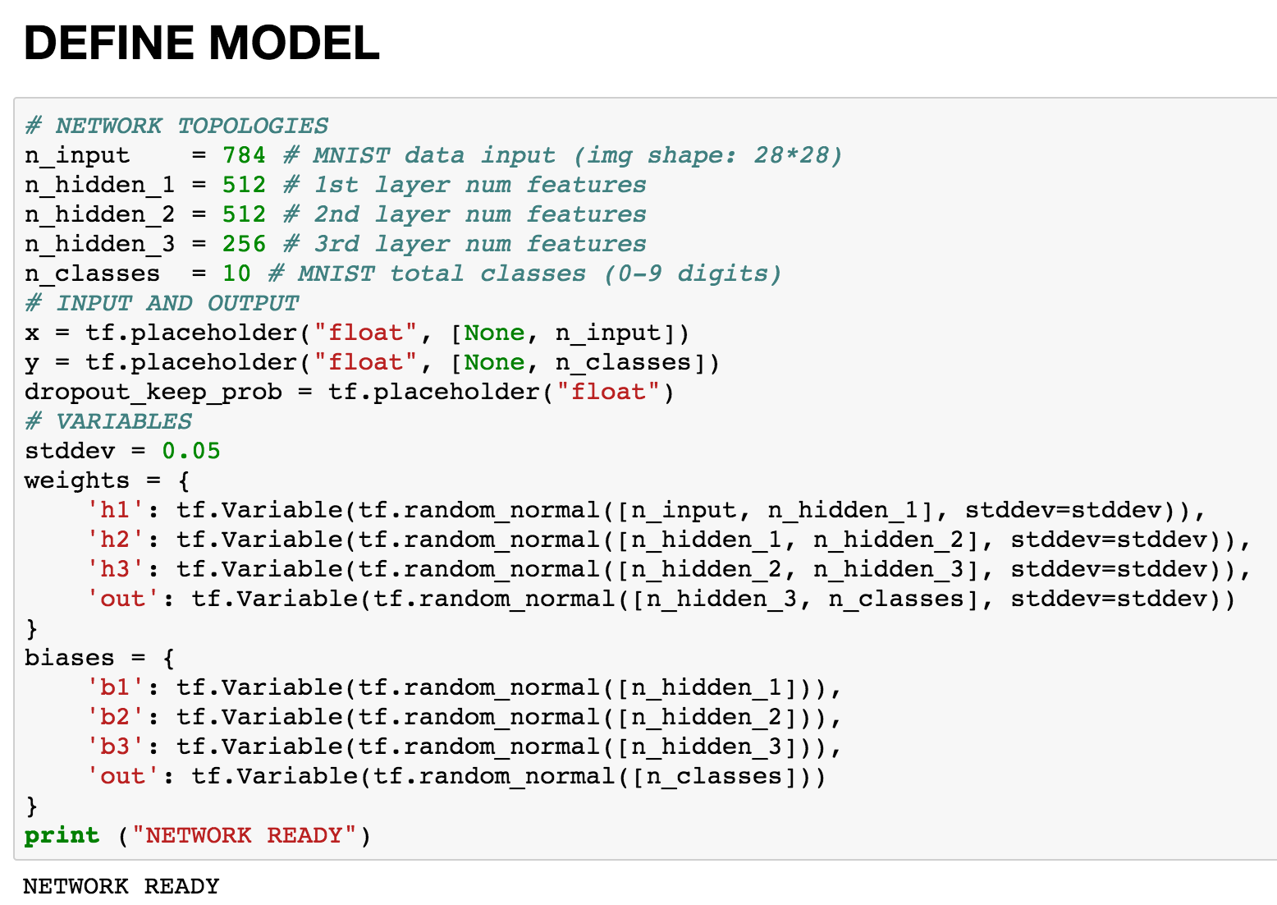

Slide 22
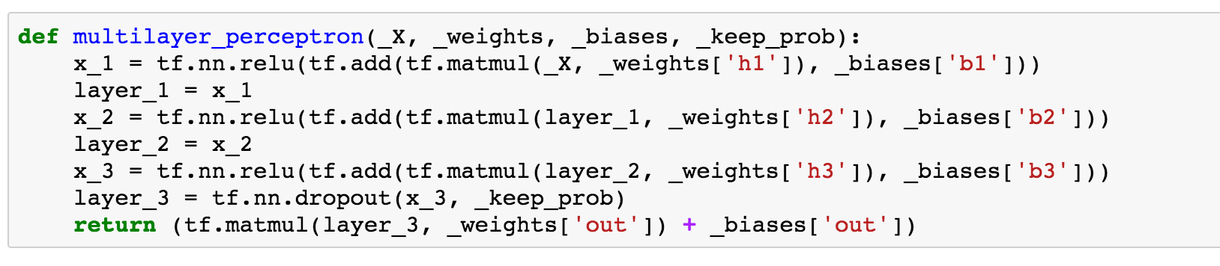

Slide 23
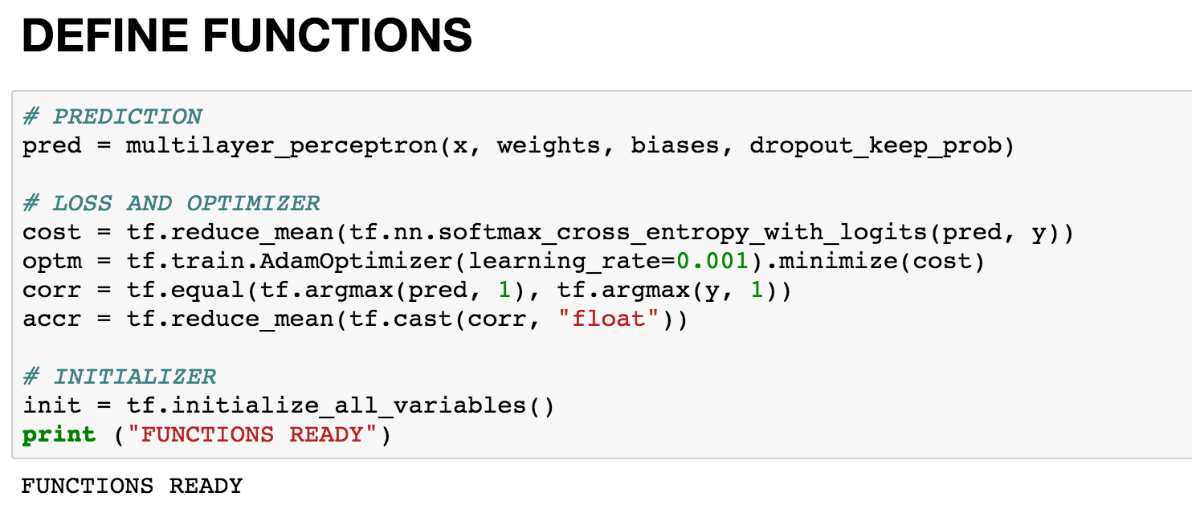

Slide 24
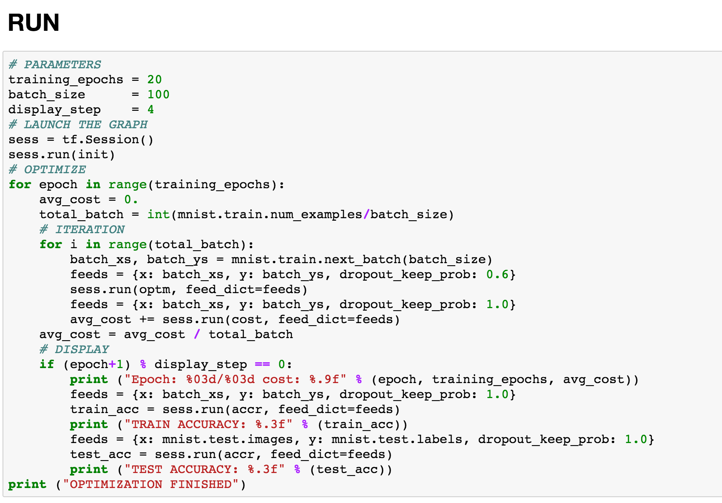

Slide 25
